Slide 1
Web MVC-2: Apache Struts
Rimon Mikhaiel
rimon@cs.ualberta.ca

Slide 2
Agenda
Drawbacks with Web Model 1
Web Model 2 (Web MVC)
Struts framework
  Example of workflow management.
A Hello World Example

Slide 3
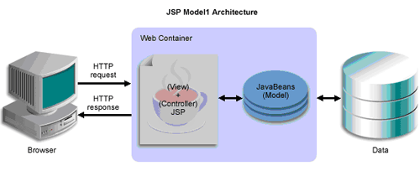
Web Model 1
In a standard J2EE web application:
  The client will typically submit information to the server via an HTTP request.
  The information is then handed over to a Servlet or a JSP which processes it, interacts with a database and produces an HTML-formatted response.
  This approaches is often considered inadequate for large projects because they mix application logic with presentation and make maintenance difficult.

Slide 4
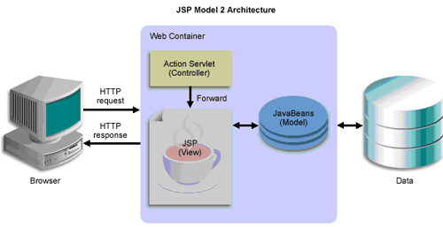
Web Model 2
Web MVC
Model: is responsible for:
  Providing the data from the database and saving the data into the data store.
  All the business logic are implemented in the Model.
  Data entered by the user through View are check in the model before saving into the database.
  Data access, Data validation and the data saving logic are part of Model.
View: is responsible for:
  Taking the input from the user,
  Dispatching the request to the controller, and then
  Receiving response from the controller and displaying the result to the user. HTML, JSPs, Custom Tag Libraries and Resources files are the part of view component.
Controller: is intermediary between Model and View; is responsible for:
  Receiving the request from client.
  Executing the appropriate business logic from the Model, and then
  Producing the output to the user using the View component. ActionServlet, Action, ActionForm and struts-config.xml are the part of Controller.

Slide 5
MVC Frameworks
J2EE:
  Struts
  Spring MVC
PHP
  CakePHP
  Strusts4php
C#.NET
  Girders
Ruby on Rails

Slide 6
Struts Framework
Apache open source web application framework (it is free).
Base on Model 2 MVC architecture.
Supports J2EE web application
  “Write once, Run Anywhere”
  Supports different model implementation (Javabeans, EJB, etc.)
Extends the Java Servlet API.
  Supports different presentation implementation (JSP, XML/XSLT, JSF).
Supports internationalization (I18N).
  Enable Multi-language applications
Supports application wide standard (error) message.

Slide 7
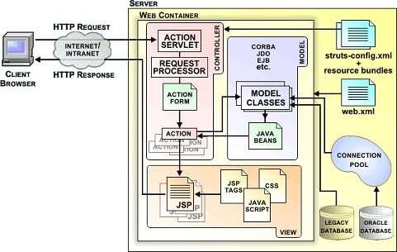
The struts architecture
<action-mappings>
<action
path="/login"
type=“com.myproject.action.LoginAction" >
<forward name=“success" path="/jsp/MainMenu.jsp" />
<forward name=“fail" path="/jsp/LoginView.jsp" />
</action>
</action-mappings>
http://my-company.com/login.action
class LoginForm extends ActionForm
{
String username,password;
public String getUsername(){
return username;
}
public void setUsername(String username){
this.username=username;
}
public String getPassword(){
return password;
}
public void setPassword(String password){
this.password=password;
}
}

Slide 8
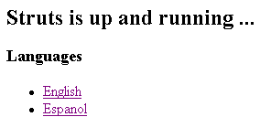
Working with Struts
From strut’s official download page http://struts.apache.org/download.cgi:
  From the recent release, download Struts2-blank.war
  Rename Struts2-blank.war to YourProjectName.war (say MyStruts.war)
  Make sure that your tomcat is up and running.
  Copy MyStruts.war under ~/catalina/webapps/ the war file will be automatically extract itself under the same directory (~/catalina/webapps/MyStruts).
  Restart your tomcat.
  Test your Struts application through:
  http://machine.cs.ualberta.ca:port/ YourProjectName
  (http://ui01.cs.ualberta.ca:17067/MyStruts)
  You should see the following screen:

Slide 9
Struts application structure
MyStruts
  |-- META-INF
  |-- WEB-INF (jars, classes, and configurations)
  |-- example (jsp files) (optional)
  `-- index.html (front page) (optional)
MyStruts/WEB-INF/classes
  |-- example (package example, you can find the source under ‘MyStruts/WEB-INF/src/java/example/’)
  | |-- ExampleSupport.class
  | |-- HelloWorld.class
  | |-- Login-validation.xml
  | |-- Login.class
  | |-- package.properties
  | `-- package_es.properties
  |-- example.xml
  `-- struts.xml

Slide 10
Hello World (JSP page)
Create a directory: ~/catalina/webapps/MyStruts/jsps
Under the above directory, create the following HelloWorld.jsp
<%@ taglib prefix="s" uri="/struts-tags" %>
<html>
<head>
<title>Hello World!</title>
</head>
<body>
<h2><s:property value="message" /></h2>
</body>
</html>

Slide 11
Hello World (Action)
Create a directory ~/catalina/webapps/MyStruts/WEB-INF/src/c410 to store your java source code for a package “c410”
Create HelloWorld.java under the above directory.
While being under the above directory, compile source code using:
javac -classpath "../../lib/xwork-2.0.4.jar" HelloWorld.java
Create a directory ~/catalina/webapps/MyStruts/WEB-INF/classes/c410 and copy the generate HelloWorld.class under this directory
package c410;
import com.opensymphony.xwork2.ActionSupport;
public class HelloWorld extends ActionSupport {
public static final String MESSAGE = "Struts is up and running ...";
private String message;
public String execute() throws Exception {
setMessage(MESSAGE);
return SUCCESS;
}
public void setMessage(String message){
this.message = message;
}
public String getMessage() {
return message;
}
}

Slide 12
Hello World (Mapping)
Modify ~/catalina/webapps/MyStruts/WEB-INF/classes/struts.xml to look like:
<!DOCTYPE struts PUBLIC
"-//Apache Software Foundation//DTD Struts Configuration 2.0//EN"
"http://struts.apache.org/dtds/struts-2.0.dtd">
<struts>
<package name="c410" extends="struts-default">
<action name="HelloWorld" class="c410.HelloWorld">
<result>/jsps/HelloWorld.jsp</result>
</action>
<!-- Add your actions here -->
</package>
</struts>

Slide 13

Run HelloWorld
You can run it through http://machine.cs.ualberta.ca:port/MyStruts/HelloWorld.action You should get something like the following screen

Slide 14
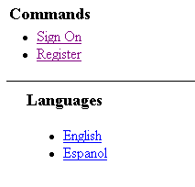
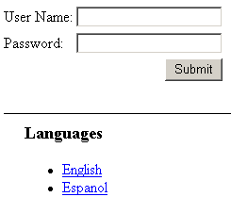
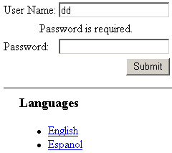
Exercise for next class
Implement a simple bi-lingual (e.g. English, French, Spanish, etc) login screen:
  Validate that both user-name and password are given
  When user-name/password are given you display a message “This page is under construction”
  When the user clicks on “Sign On”, you display the same message “This page is under construction”

Slide 15
References
Struts Offical Home Page
Apache Struts2 Documentation: Bootstrap
Struts Guide
What is Struts?

